Slide 1
ME 245
Engineering Mechanics and Theory of Machines
Portion 2
Introduction to Statics
Partha Kumar Das
Lecturer
Department of Mechanical Engineering, BUET
http://teacher.buet.ac.bd/parthakdas/

Slide 2
Forces in a Space (3D Analysis)
Forces in a Plane (2D Analysis)
Statics of Particle

Slide 3
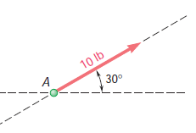
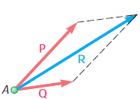
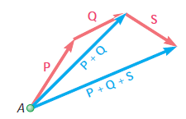
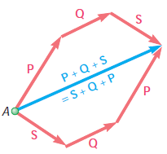
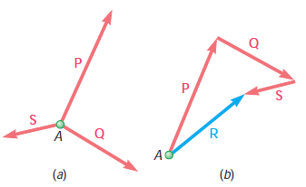
Forces in a Plane
Forces on a Particle
Point Force
Vector
Resultant of Multiple Forces
Addition of Vectors
Triangle Rule
Parallelogram Law
Polygon Rule
Resultant of Concurrent Forces

Slide 4
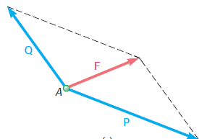
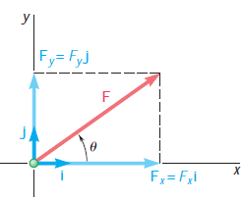
Forces in a Plane
Forces on a Particle
Resolution of Forces into Components
Rectangular Components
Unit Vectors
F = Fxi + Fyj

Slide 5
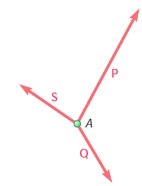
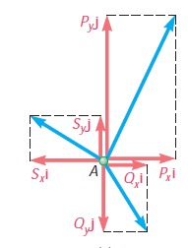
Forces in a Plane
Forces on a Particle
Addition of Forces Using its Components
Resolving into Components

Slide 6
Forces in a Plane
Forces on a Particle
Equilibrium of a Particle
The three forces will be in equilibrium if and only if R = ∑F = 0
∑Fx = ∑Fy = 0
Remember Newton
If the resultant force acting on a particle is zero, the particle
will remain at rest (if originally at rest) or will move with constant
speed in a straight line (if originally in motion).

Slide 7
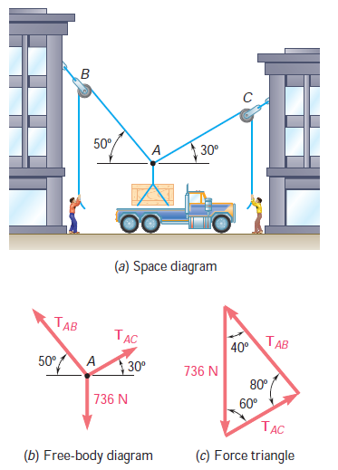
Forces in a Plane
Forces on a Particle
Free Body Diagram of a Particle
Suppose 75 kg crate equivalent to 736 N weight is to be lifted using rope-pulleys.
We need to know whether the ropes can carry the load or not i.e. we need to determine the tension in the individual rope.
Steps:
Draw a Free Body Diagram of the most significant point, here it is P.
Resolve the components of the force or use triangle rule to find out two equations for the two unknown force.
Free Body Diagram is specially necessary in problem where a particle is in equilibrium condition.

Slide 8
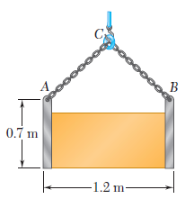
Problem 2.2 (Beer Johnston_10th edition_P2.62)
A movable bin and its contents have a combined weight of 2.8 kN. Determine the shortest chain sling ACB that can be used to lift the loaded bin if the tension in the chain is not to exceed 5 kN.
Solution:
Free Body Diagram of Point C:
W = 2.8 kN
C
T1 = 5 kN
T2 = 5 kN
1.2 m
Ans.: ACB = 1.25 m

Slide 9
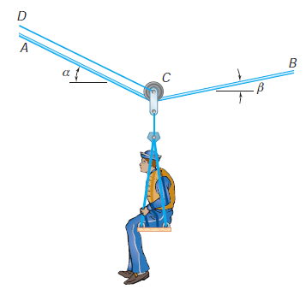
Problem 2.2 (Beer Johnston_10th edition_P2.53)
A sailor is being rescued using a boatswain’s chair that is suspended from a pulley that can roll freely on the support cable ACB and is pulled at a constant speed by cable CD. Knowing that α = 30°, β= 10° and that the combined weight of the boatswain’s chair and the sailor is 900 N, determine the tension (a) in the support cable ACB, (b) in the traction cable CD.

Slide 10
Forces in a Space
Forces on a Particle
F = Fxi + Fyj + Fzk
Fx= F cosθx
Fy= F cosθy
Fz= F cosθz

Slide 11
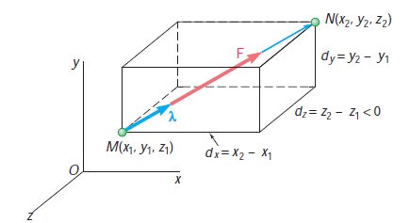
Forces in a Space
Forces on a Particle
Force Determination from its Line of Action
Steps:
MN = dxi + dyj + dzk
Unit Vector, λ = MN/MN = (dxi + dyj + dzk)/ d
F = F λ
If origin is not given, assume any suitable origin.

Slide 12
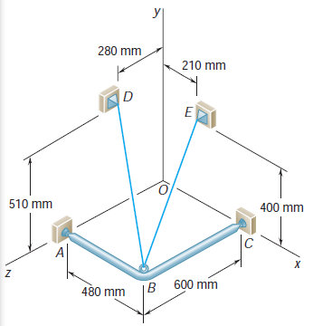
Problem 2.3 (Beer Johnston_10th edition_P2.89)
A frame ABC is supported in part by cable DBE that passes through a frictionless ring at B. Knowing that the tension in the cable is 385 N, determine the components of the force exerted by the cable on the support at D.
Solution:
DB = (480 mm) i – (510 mm) j + (320 mm) k
DB = 770 mm
Force on D, F = F λ = (240 N) i – (255 N) j + (160 N) k
Ans.: Components of force on D towards B exerted by the cable DB, Fx = +240 N, Fy = -255 N, Fz = +160N

Slide 13
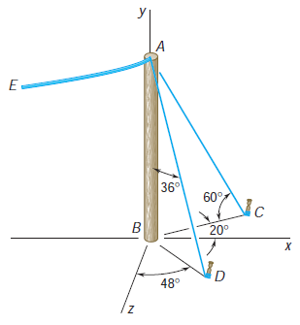
Problem 2.4 (Beer Johnston_10th edition_P2.77)
The end of the coaxial cable AE is attached to the pole AB, which is strengthened by the guy wires AC and AD. Knowing that the tension in wire AC is 120 N, determine (a) the components of the force exerted by this wire on the pole, (b) the angles θx, θy, and θz that the force forms with the coordinate axes.

Slide 14
Forces in a Space
Forces on a Particle
Equilibrium
∑ F = ∑ Fxi + ∑ Fyj + ∑ Fzk = 0
∑ Fx= 0
∑ Fy= 0
∑ Fz= 0

Slide 15
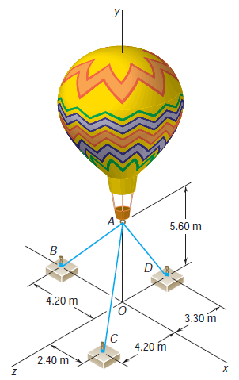
Problem 2.5 (Beer Johnston_10th edition_P2.102)
Three cables are used to tether a balloon as shown. Knowing that the balloon exerts an 800 N vertical force at A, determine the tension in each cable.
Solution:
Draw the Free Body Diagram of point A.
Equilibrium Condition of A:
ΣF = 0
So, TAB + TAC + TAD + P = 0
AB = -4.2 i - 5.6 j
AC = 2.4 i - 5.6 j + 4.2 k
AB = -5.6 j – 3.3 k
Ans.: TAB = 201 N, TAC = 372 N, TAD = 416 N

Slide 16
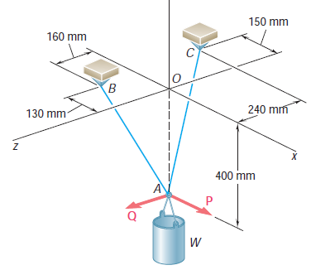
Problem 2.6 (Beer Johnston_10th edition_P2.123)
A container of weight W is suspended from ring A. Cable BAC passes through the ring and is attached to fixed supports at B and C. Two forces P and Q are applied to the ring to maintain the container in the position shown. Knowing that W = 376 N, determine P and Q.
(Hint: The tension is the same in both portions of cable BAC.)

Slide 17
Statics of Rigid Bodies

Slide 18
Free Body Diagram
Free Body Diagram of the Truck:

Slide 19
Principle of Transmissibility
Rigid Body Assumption
Deformation of the body under a force is negligible and has no effect on the condition of equilibrium or motion of the body.

Slide 20
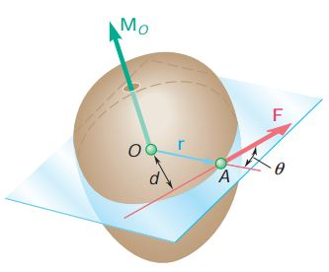
Moment of a Force About a Point
Mo = r x F = rA/O x F
Mo = rF sin θ = Fd

Slide 21
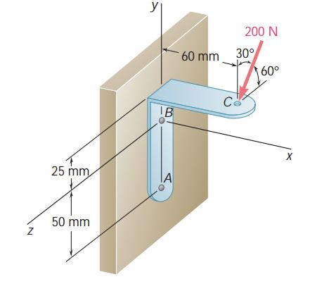
Problem 2.7 (Beer Johnston_10th edition_P3.25)
A 200-N force is applied as shown to the bracket ABC. Determine the moment of the force about A.
Solution:
MA = r C/A x F
r C/A = (0.06 m ) i + (0.075 m ) j
F = - 200 N (cos 30°) j + 200 N (cos 60°) k
MA = (7.5 Nm) i – (6 Nm) j – (10.39 Nm) k
Ans.: MA = (7.5 Nm) i – (6 Nm) j – (10.39 Nm) k

Slide 22
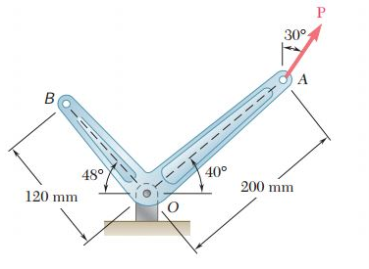
Problem 2.8 (Beer Johnston_10th edition_P3.6)
A 300-N force P is applied at point A of the bell crank shown.
(a) Compute the moment of the force P about O by resolving it into horizontal and vertical components.
(b) Using the result of part a, determine the perpendicular distance from O to the line of action of P.
Solution:
(a)
M O= r A/O x F
r A/O = (0.153209 m ) i + (0.128558 m ) j
F = 300 N (sin 30°) i + 300 N (cos 30°) j
MO = (20.521 Nm) k
Ans.: (a) MO = (20.521 Nm) k or MO = 20.521 Nm (b) d = 68.4 mm

Slide 23
Problem 2.9 (Beer Johnston_10th edition_P3.7)
A 300-N force P is applied at point A of the bell crank shown.
Compute the moment of the force P about O by resolving it into along line OA and perpendicular to OA.

Slide 24
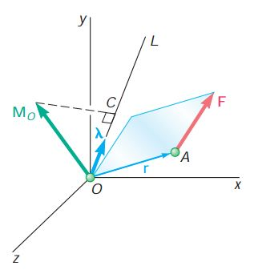
Moment of a Force About a Given Axis
A scalar Quantity
The projection of Moment on a given axis.
Moment of force about Point O
MO = r A/O x F
Moment of force about Axis OL
MOC = λ . MO
MOC = λ . (r A/O x F)
MOC =
λx | λy | λz
rx | ry | rz
Fx | Fy | Fz
λ is the unit vector along OL

Slide 25
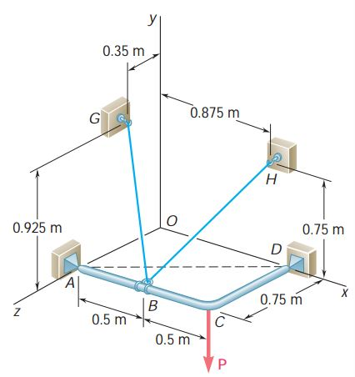
Problem 2.10 (Beer Johnston_10th edition_P3.59)
The frame ACD is hinged at A and D and is supported by a cable that passes through a ring at B and is attached to hooks at G and H. Knowing that the tension in the cable is 450 N, determine the moment about the diagonal AD of the force exerted on the frame by portion BH of the cable.
Solution:
Moment of force TBH about Point A
MA = r B/A x T BH
Moment of force TBH about Axis AD
MAD = λAD . MA
AD = i – 0.75j AD = 1.25
λAD = (0.8i – 0.6k)
r B/A = 0.5i
BH = 0.375i + 0.75j -0.75k
BH = 1.125 m
λBH = (i + 2j -2k)/ 3
T BH = 150 (i + 2j -2k)
MAD = -90 Nm
Ans.: -90 Nm

Slide 26
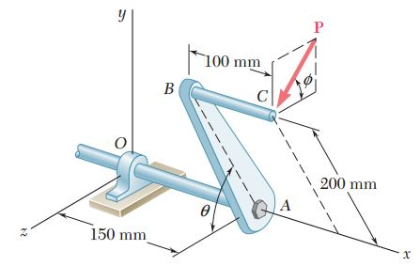
Problem 2.11 (Beer Johnston_10th edition_P3.53)
A single force P acts at C in a direction perpendicular to the handle BC of the crank shown. Knowing that Mx = +20 N m and My = -8.75 N m, and Mz = -30 N m. Determine the magnitude of P and the values of θ and ɸ.
Ans.: P = 125 N, θ =53.1 °, ɸ = 73.7°

Slide 27
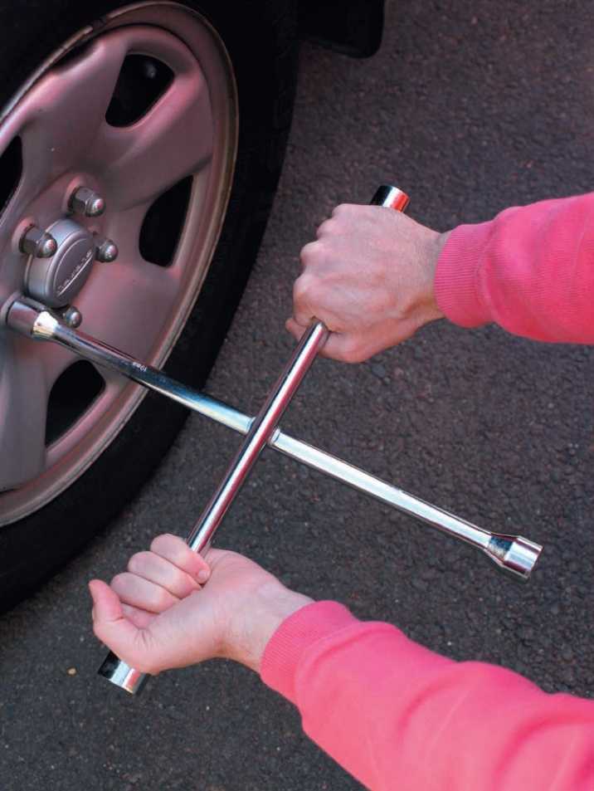
Force, Torque and Couple
Applying Torque
Couple

Slide 28
Moment of a Couple
Moment of a Couple = Sum of the moment of corresponding two forces about ANY point
rA x F + rB x (-F) = (rA - rB ) x F
M = r x F
Value of the Moment, M = rF sin θ = rd
[d is the perpendicular distance between the line of action of the two forces]
Direction of the moment is perpendicular to the plane containing the two forces

Slide 29
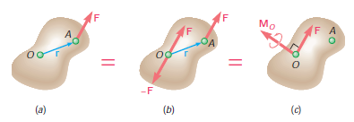
Force-Couple System
A force can be resolved into an equivalent force-couple system at any point.

Slide 30
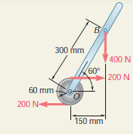
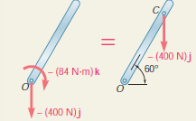
Problem 2.12 (Beer Johnston_10th edition_Sample Problem 3.7)
Replace the couple and force shown by an equivalent single force applied to the lever. Determine the distance from the shaft to the point of application of this equivalent force.
Solution:
Moment of F = 400 N force about Point O
MO = OB x F
= [300m (cos 60°) i + 300m (sin 60°) j] x (-400 N) j
= (-60 Nm) k
Total Moment at O,
M = [-60+ (-200 N * 120 mm)] k
= (-84 Nm) k
So,
OC x F = M
[(OC) cos 60° i + (OC) sin 60° j] x (-400 N) j = (-84 Nm) k
[(OC) cos 60° * (-400 N)] k = (-84 Nm) k
(OC) cos 60° = 0.210 m = 210 mm
OC = 420 mm
Ans.: OC = 420 mm

Slide 31
End of Portion 2

Slide 32
References
Vector Mechanics for Engineers: Statics and Dynamics
Ferdinand Beer, Jr., E. Russell Johnston, David Mazurek, Phillip Cornwell.

